Slide 1

Toolkit Doc14 Fore Arm
May 4, 2010

Slide 2
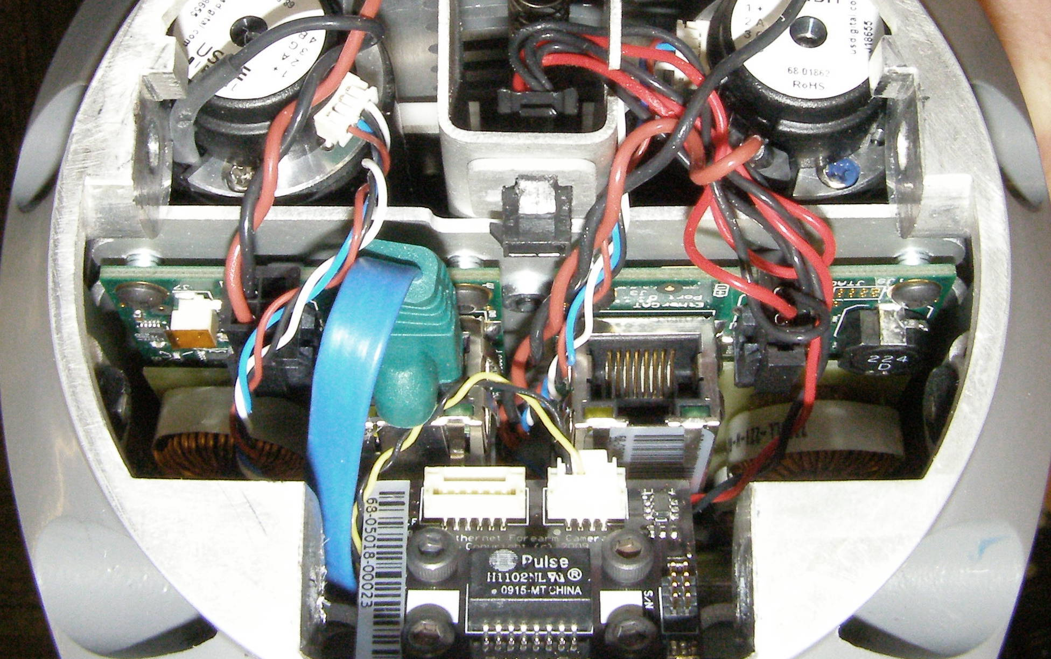
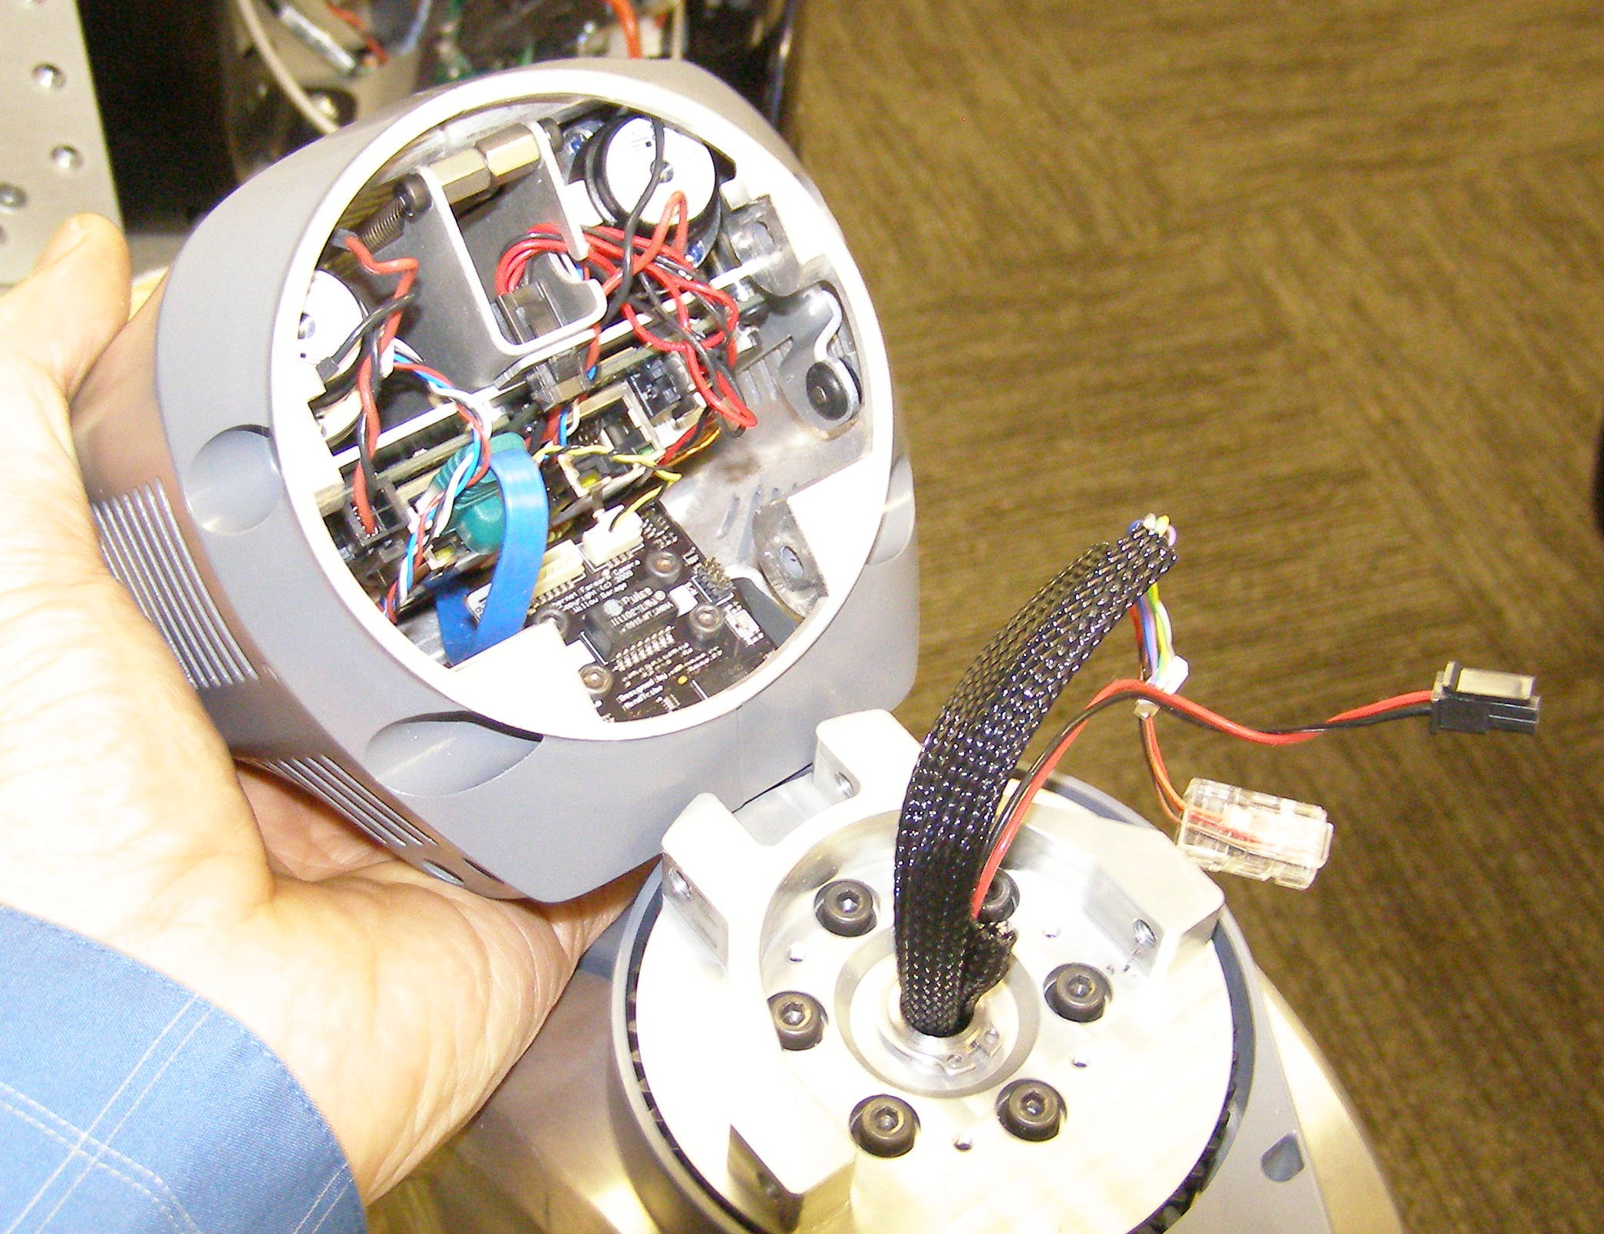
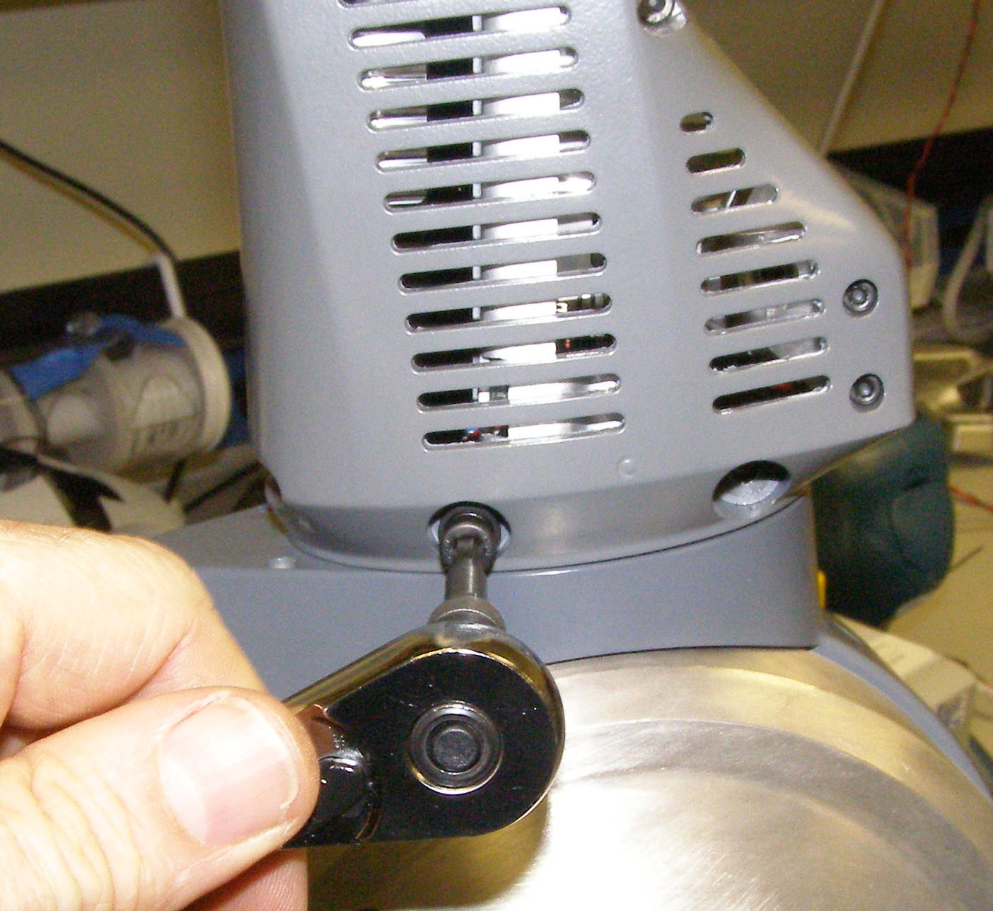
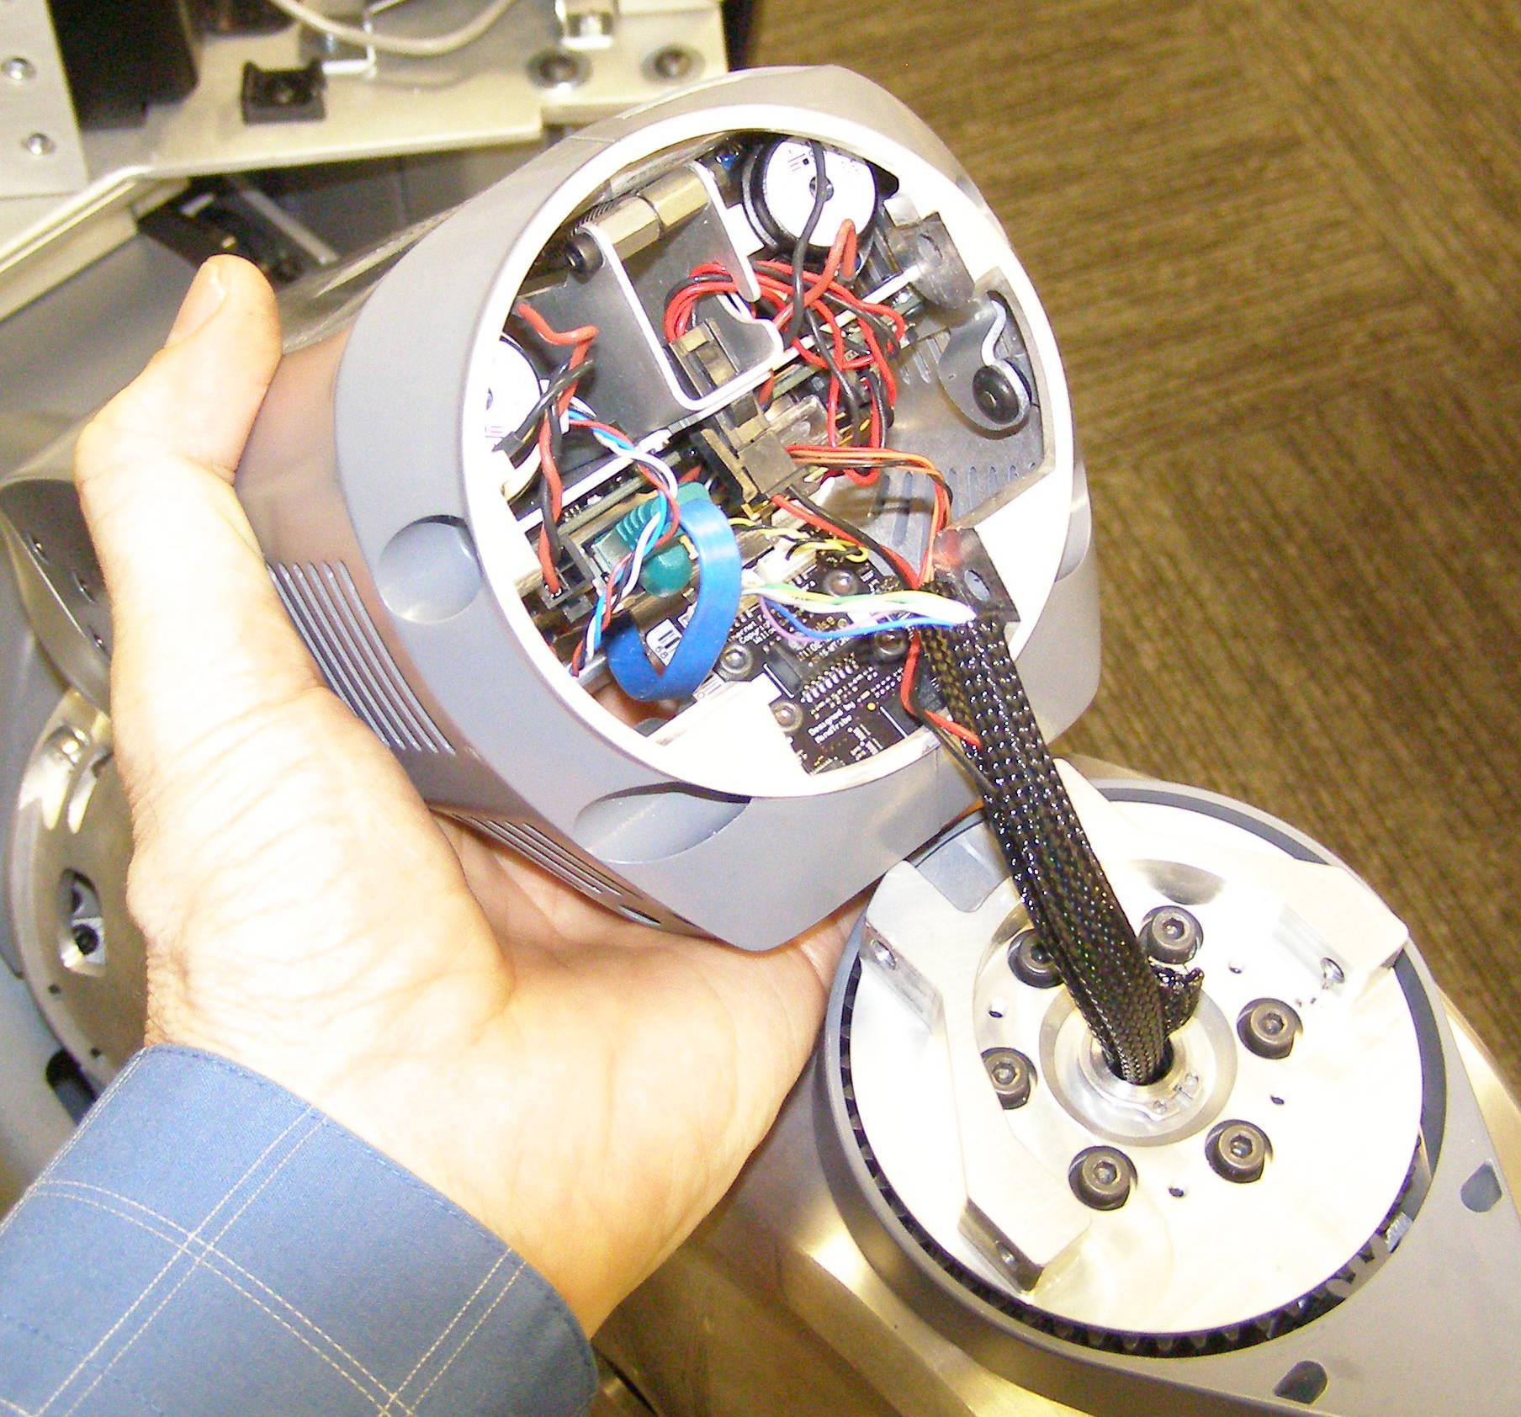
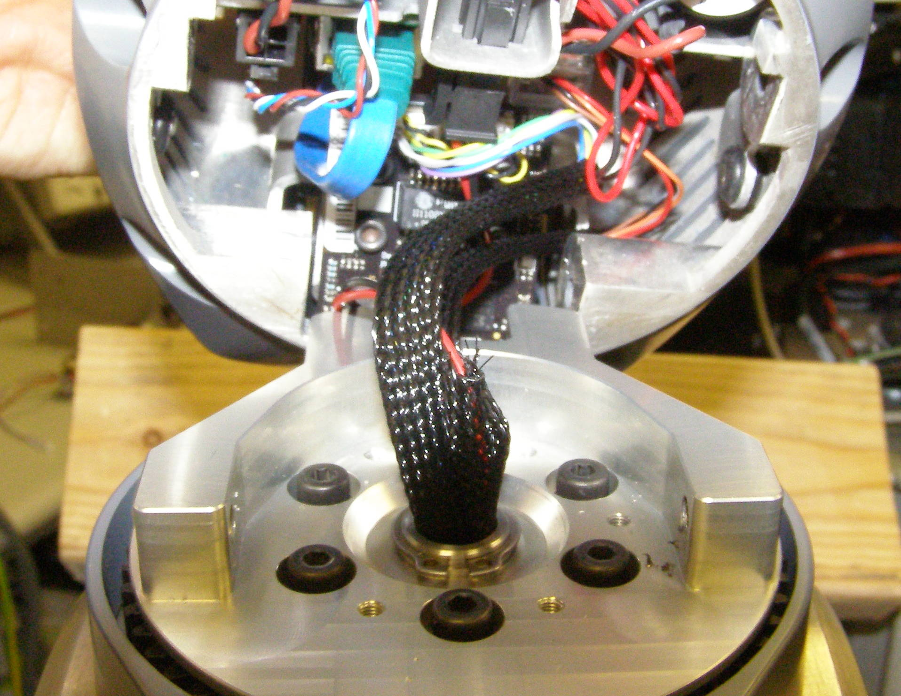
Fore Arm R/R
Fore Arm, Removal - 4213
  Remove Gripper.
  Remove Cover - 2546
  With the Fore Arm pointing up and using the 4mm bit with the T-handle driver, remove 4 screws, 2 on each side of the Fore Arm. Be careful that the Fore Arm does not fall off when you release the screws. Caution: the Upper Arm will rise with conciderable force when the Fore Arm is removed! 2018-20
  (Fig 1)
  Pull the Fore Arm off by gently walking it from side to side. As soon as it is off tilt the Fore Arm towards the Robot to expose the cables that will need to be disconnected. (Fig 2)
  Disconnect the 3 cables as shown. They each have a latching mechanism that needs to be released to disconnect. (Fig 3,4)
Fig 3
Fig 4
Fig 1
Fore Arm, Install
  Snap the 3 cables into place starting with the large clear plastic one (RJ45).
  Line up the Aluminum bosses and tuck the cables into the space on the right side as shown. (Fig 5)
  Rotate the Fore Arm into place, you may have to rock it from side to side similar to the removal procedure to get it to fully seat.
  Using Loctite 248, install the 4 screws and torque to 6.34Nm using the Large torque driver.
Fig 2
Fig 5

